Slide 1
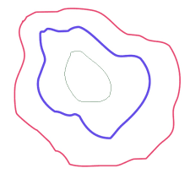
Contours
A Contour is a curve joining all the continuous points (along the boundary), having same colour or intensity. Contours are a useful tool for shape analysis and object detection and recognition.

Slide 2
cv2.findContours()
Contours are detected via the cv2.findContours()
For better accuracy use binary images. Threshold or use canny edge detection before using(Note: Canny will give inner and outer border as 2 discrete contours)
Parameters:
Source Image, Contour Retrieval Mode, Contour Approximation method.
The Contours are returned as a numpy array, along with hierarchy.

Slide 3
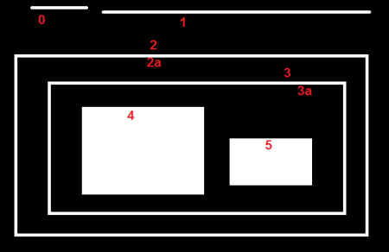
cv2.findContours() params
Retrieval Modes:
RETR_LIST
Builds a hierarchy without any parent child relationships
RETR_EXTERNAL
Returns only extreme outer contours
RETR_CCOMP
Establishes two level hierarchy(Inner and Outer)
RETR_TREE
Returns all contours and establishes full family hierarchy

Slide 4

cv2.findContours() params
Approximation Methods:
CHAIN_APPROX_NONE
Returns all the points along the contour
CHAIN_APPROX_SIMPLE
compresses horizontal, vertical, and diagonal segments and leaves only their end points.

Slide 5
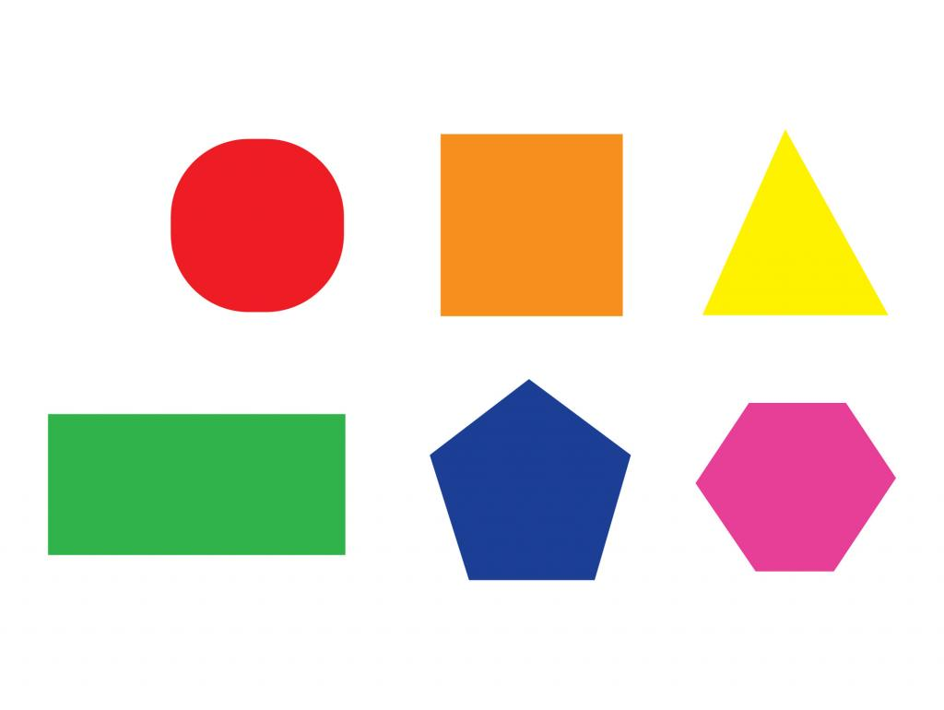
Task
Retrieve the contours from the image

Slide 6
Code
import numpy as np
import cv2
#Read in the Source Image
img = cv2.imread('cv2.findContours.jpg')
#Convert it to grayscale, blur and threshold. End result is a binary image
img_gray = cv2.cvtColor(img, cv2.COLOR_BGR2GRAY)
tmp = cv2.medianBlur(img_gray, 5)
_, thresh = cv2.threshold(tmp, 230, 255, cv2.THRESH_BINARY_INV)

Slide 7
Code
#Find the contours
im2, contours, hierarchy = cv2.findContours(thresh,cv2.RETR_TREE,cv2.CHAIN_APPROX_SIMPLE)
#Print the result
print(len(contours))
print(contours)
#Show the source image and the operations one by one
cv2.imshow('img', img)
cv2.imshow('Grayscale', img_gray)
cv2.imshow('Blurred', tmp)
cv2.imshow('Binary', thresh)

Slide 8
cv2.drawContours()
This function takes contours and draws them on an image.
Task:
Draw the contours obtained on the image
Try manipulating the code to draw only specific contours
Parameters:
Image, contours, contour index, colour, thickness
Note that contour index of -1 draws all the contours

Slide 9
Contour Features
1. Area:
area = cv2.contourArea(cnt)
Returns Area of the contour cnt
2. Perimeter:
perimeter = cv2.arcLength(cnt,True)
Returns perimeter. Second argument is True if contour is closed.
3.. Bounding Rectangle:
x,y,w,h = cv2.boundingRect(cnt)
Returns coordinates of top left corner, width and height

Slide 10
Task
using Contour Properties, Find the area, perimeter and Bounding rectangle of the shapes in the image

Slide 11
Code
import numpy as np
import cv2
#The same as before
img = cv2.imread('cv2.findContours.jpg')
img_gray = cv2.cvtColor(img, cv2.COLOR_BGR2GRAY)
tmp = cv2.medianBlur(img_gray, 5)
_, thresh = cv2.threshold(tmp, 230, 255, cv2.THRESH_BINARY_INV)
im2, contours, hierarchy = cv2.findContours(thresh,cv2.RETR_TREE,cv2.CHAIN_APPROX_SIMPLE)
cv2.imshow('Grayscale', img_gray)
cv2.imshow('Blurred', tmp)
cv2.imshow('Binary', thresh)

Slide 12
Code
for cnt in contours:
area = cv2.contourArea(cnt)
perimeter = cv2.arcLength(cnt,True)
x,y,w,h = cv2.boundingRect(cnt)
print(area)
print(perimeter)
cv2.rectangle(img,(x,y),(x+w,y+h),(0,255,0),2)
cv2.imshow('img', img)

Slide 13

Morphological Transforms
Morphological Transforms are simple operations based on the shape of an image.
They are generally used to reduce noise.
These transforms need two inputs, the source image and the kernel.
A kernel is a filtering element that is slid over the image to produce a filtered image.
The kernel is superimposed individually over each pixel of the source image, and selected operations are performed on the region superimposed

Slide 14

Working of a Kernel

Slide 15

Erosion
erosion=cv2.erode(img,kernel,iterations= 1)
Erosion takes a kernel and checks all the pixels. If even one pixel is black, the pixel is set to black.(Binary)
It is used to remove external noise.
Parameters:
Source Image
Kernel
Number of iterations

Slide 16
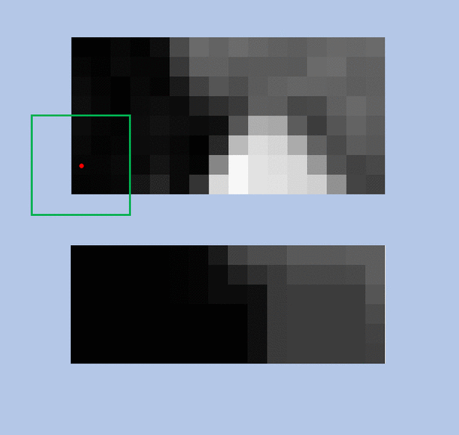
Grayscale Erosion

Slide 17

Dilation
dilation=cv2.dilate(img,kernel,iterations=1)
Dilate takes a kernel and checks all the pixels. If even one pixel is white, the pixel is set to white.(Binary)
It is used to remove internal noise.
Parameters:
Source Image
Kernel
Number of iterations

Slide 18
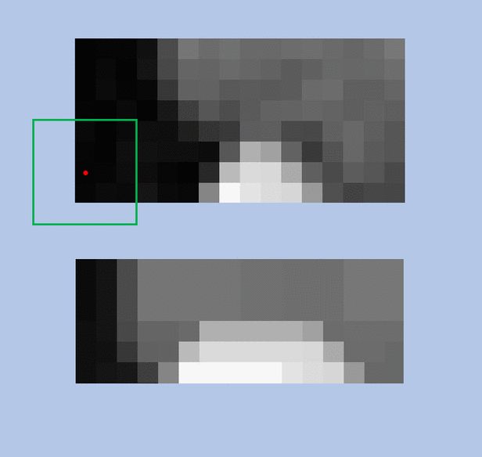
Grayscale Dilation

Slide 19


Opening and Closing
These are simply erosion followed by dilation and dilation followed by erosion respectively.
Opening:
cv2.morphologyEx(img,cv2.MORPH_OPEN, kernel)
Closing:
cv2.morphologyEx(img,cv2.MORPH_CLOSE, kernel)

Slide 20



Other Transforms
Apart from the previous transforms, there are other transforms built over the basic erosion and dilation.
Gradient:
Dilation – Erosion
cv2.morphologyEx(img, cv2.MORPH_GRADIENT, kernel)
Black Hat:
Closing – Source
cv2.morphologyEx(img, cv2.MORPH_BLACKHAT, kernel)
Top Hat:
Source – Opening
cv2.morphologyEx(img, cv2.MORPH_TOPHAT, kernel)

Slide 21
Task
Apply the morphological transforms to a Video Feed and see the results!

Slide 22
import numpy as np
import cv2
cap = cv2.VideoCapture(0)
while(True):
ret, img = cap.read()
gray = cv2.cvtColor(img, cv2.COLOR_BGR2GRAY)
kernel = np.ones((5,5),np.uint8)
erosion = cv2.erode(gray,kernel,iterations = 1)
dilation = cv2.dilate(gray,kernel,iterations = 1)

Slide 23
Code
cv2.imshow('frame',gray)
cv2.imshow('eroded',erosion)
cv2.imshow('dilated',dilation)
if cv2.waitKey(1) & 0xFF == ord('q'):
break
cap.release()
cv2.destroyAllWindows()

